Slide 1
The spread of a gene Question 4
Hooi Min Tan Grahn

Slide 2
The overarching scope
Mechanisms driving evolution
It involves understanding the dynamics of gene spread within populations and the factors influencing the maintenance or loss of specific genetic traits.
This field explores how genetic variation arises and spreads over time, shaping the diversity of species and their adaptations to different environments.
Notes:
driving forces of evolution in any population are mutation, natural selection, genetic drift, and gene flow. The ability of these driving forces to perform their role is dependent on the amount of genetic diversity within and among populations

Slide 3
Specific scope and scientific impact
By studying gene spread and equilibrium frequencies, scientists gain insights into how genetic variations arise and persist within populations, therein understanding the evolutionary dynamics
Understanding these dynamics helps predict how specific traits might evolve or spread over time and predicting genetic futures
Assessing the genetic diversity within endangered populations to devise conservation strategies
Studying the spread of beneficial traits in crops or livestock to enhance yields and resilience in agriculture

Slide 4
Specific questions
Analyzing the equilibrium frequencies and stability of a focal gene (gene A, in this case) within a population.
Assessing the influence of stochasticity (random deviates) on the fate of the focal gene.
Assessing fixation probabilities and the impact of stochasticity allows quantifying the risks associated with losing or gaining certain genetic traits within populations.
Examining the impact of population size and the range of fitness values on gene spread.

Slide 5
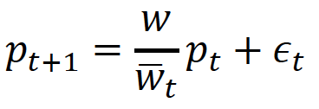

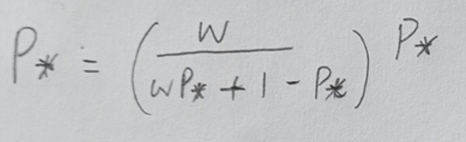
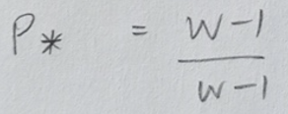
General and specific description of question 4a
I solved question 4a by solving equation 1 mathematically, by replacing wt bar and by rearranging these combination of equations together.
Equation 1 →
When p_{t} reaches equilibrium, p_{t+1} and p_{t} = p*
p* = 0 is a trivial solution,
while p* = 1 is a nontrivial solution
while w is not equals to 1
p* = 1 and it is depended on the fitness w
1.0
-1.0
0.0
1.0

Slide 6
General and specific description of question 4a
When discussing the frequency of a gene reaching equilibrium (p*), it refers to a scenario where the frequency of gene A stabilizes in the population and no longer changes over time. In this context, equilibrium frequency is reached when the gene's spread (its increase or decrease in frequency) ceases, indicating a balance between its rate of increase and decrease.

Slide 7
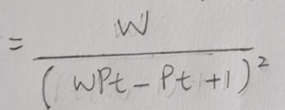
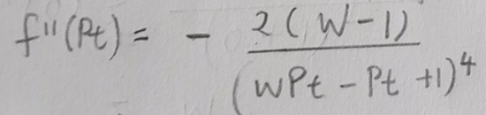
General and specific description of question 4b
I solved question 4b by solving equation 1 mathematically by using the derivative of the quotient rule and by rearranging the equation.
f’(p_{t})
To further investigate its stability, second derivative was carried out
It is stable when f’’(p*) < 0 , where the second derivative has a negative value
When the equilibrium frequency (p*) is at 0, it means that gene A has been lost from the population. In this case, the gene did not confer a fitness advantage significant enough to maintain its presence and got eliminated over time.

Slide 8
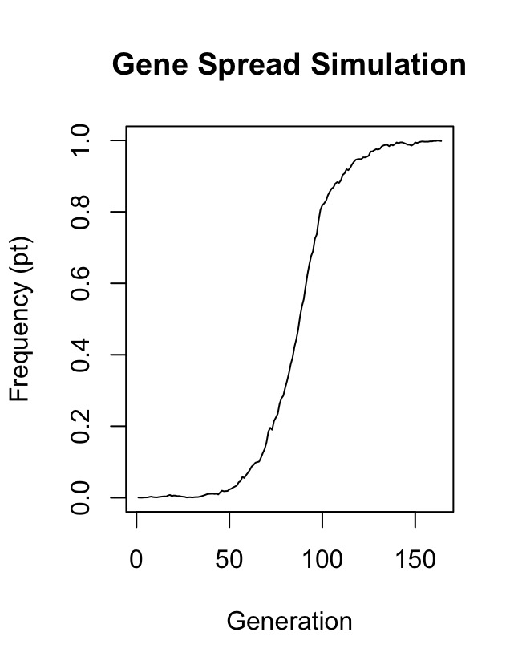
General and specific description of question 4c
I solved question 4c by coding a simulation model that includes a for loop which takes the frequency of p over n generations
Stochasticity, represented by random deviates 𝜖, introduces randomness or chance events into the gene spread dynamics. This randomness can influence the fate of gene A in the population, especially when the gene is present at low frequencies. Random deviates can impact the gene's spread, causing fluctuations or even leading to the loss of the gene, especially when the fitness advantage is not substantial.
In this simulation model, after multiple iterations (1000 simulations), these random events, influenced by the stochasticity introduced by 𝜖, with w = 1.1, favored the spread of gene ‘A’ eventually led to its increase in frequency over time.
Notes:
n <- 1000 # number of generations
N <- 1000 # population size
pt <- numeric(n) # frequency of gene A over time
w <- 1.1 # fitness of A
pt[1] <- 1 / (2 * N) # initial p value of gene A
# run simulation of p for n generations (for-loop)
# mean fitness of population A over time
# standard deviation of fitness of population A over time
# calculate p value for next generation
# Break if pt is <= 0 or >= 1
# Plot pt over time

Slide 9
General and specific description of question 4d
I solved question 4d by creating a function to calculate fixation probability on a nested for-loop which takes the number of simulations times and the frequency of p over n generations.
I established conditions when p < 0, set p value to 0, while when p value is more than 1, set p value to 1, and when p value is equals 1, add 1 to the fixation count
The calculation for fixation probability is by dividing the total fixation count over the total of number stimulations
Fixation probability refers to the likelihood of a gene reaching fixation (frequency of 1) or being lost (frequency of 0) in a population. It's influenced by selection pressure (fitness advantage), population size, and stochasticity. In smaller populations or when the fitness advantage is weak, stochastic effects play a more substantial role in fixation probability.
In this simulation, "Probability of fixation: 0.26"

Slide 10
General and specific description of question 4e
I solved question 4e by creating a function to calculate fixation probability on a nested for-loop which takes the number of simulations times and the frequency of p over n generations.
I established conditions when p < 0, set p value to 0, while when p value is more than 1, set p value to 1, and when p value is equals 1, add 1 to the fixation count
The calculation for fixation probability is by dividing the total fixation count over the total of number stimulations
To speed up the stimulations, here I run 100 of stimulations, but one can increase it to 1000, which takes 1-2 minutes.
Population Size (N = 20 vs. N = 200): In smaller populations (N = 20), random chance has a more significant impact. Fluctuations due to stochasticity can cause gene frequencies to change more rapidly and dramatically. Fixation (either loss or complete takeover) of a gene can occur more quickly.
In larger populations (N = 200), random fluctuations have less impact. The effects of stochasticity are dampened due to larger sample sizes, making it less likely for chance events to dramatically alter gene frequencies. Gene spread tends to be more stable in larger populations.

Slide 11
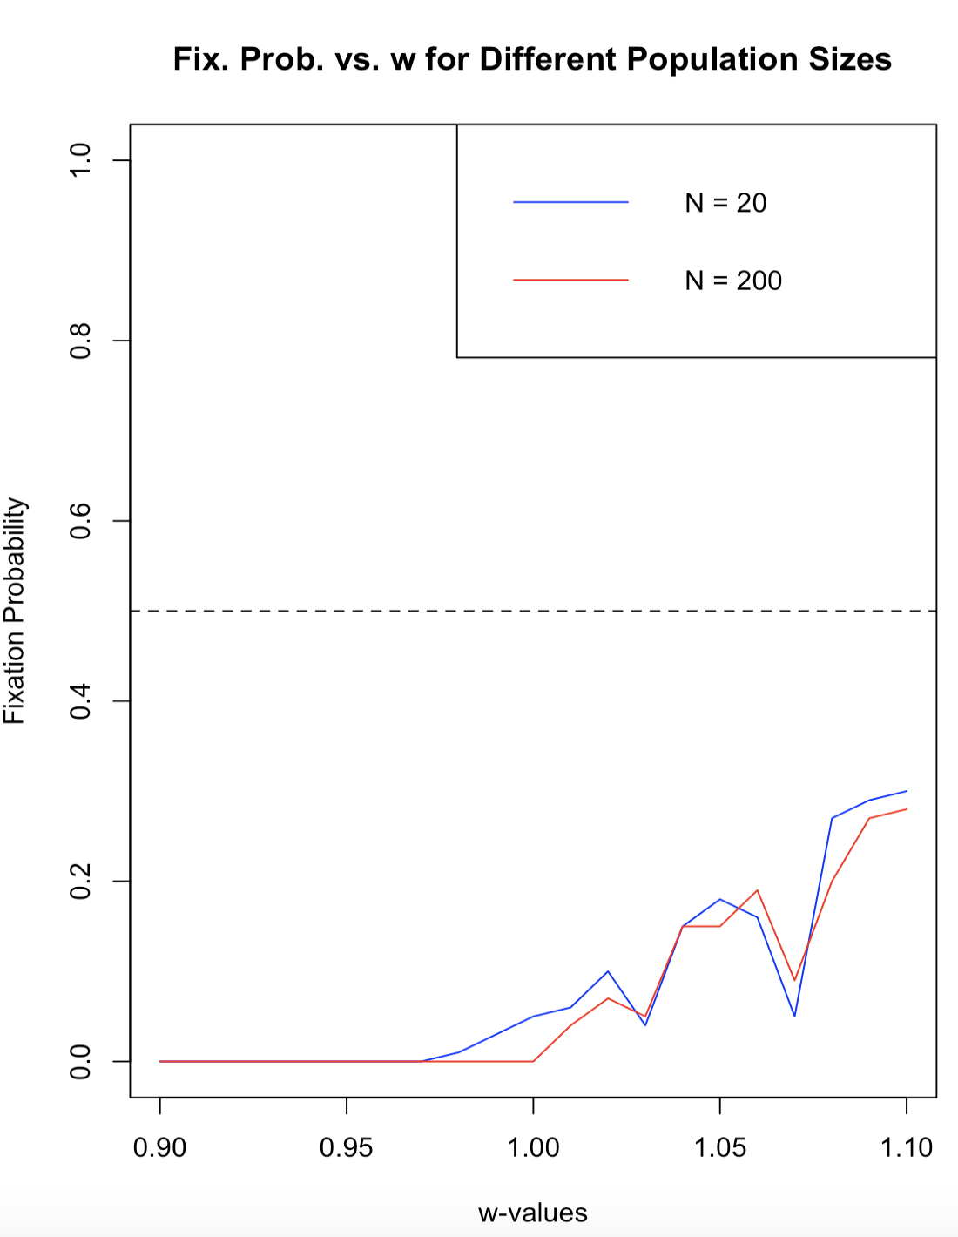
General and specific description of question 4e
Running simulations on populations of different sizes (N = 20 vs. N = 200) and varying fitness values (0.9 to 1.1) allows observation of how these factors affect the spread and stability of gene A. The simulations can demonstrate the impact of population size and fitness advantage on fixation probabilities and the time taken for a gene to reach equilibrium or be lost from the population.
Understanding these concepts aids in comprehending how genetic traits spread in populations and the interplay between selection, population size, and randomness in evolutionary processes.
Smaller population size (N = 20) was vulnerably affected when the fitness values closed to or more than 1

